Slide 1


Psoriatic arthritis & IL-17A Hussein Al-Mossawi MRCP DPhil Clinical Lecturer in Rheumatology, NDORMS Fellow and Lecturer in Pathology, St Edmund Hall University of Oxford

Slide 2
Conflict of Interest
Advisory board and educational material for Novartis
All content in presentation prepared by H Al-Mossawi without input from Novartis

Slide 3
Talk Overview
Clinical picture & Diagnosis
Genetics
T cell biology & Pathogenesis
Treatment
Case studies

Slide 4
Talk Overview
Clinical picture & Diagnosis
Genetics
T cell biology & Pathogenesis
Treatment
Case studies

Slide 5
Clinical Picture
Moll & Wright Semin Arthritis Rheum. 1973;3(1):55-78

Slide 6
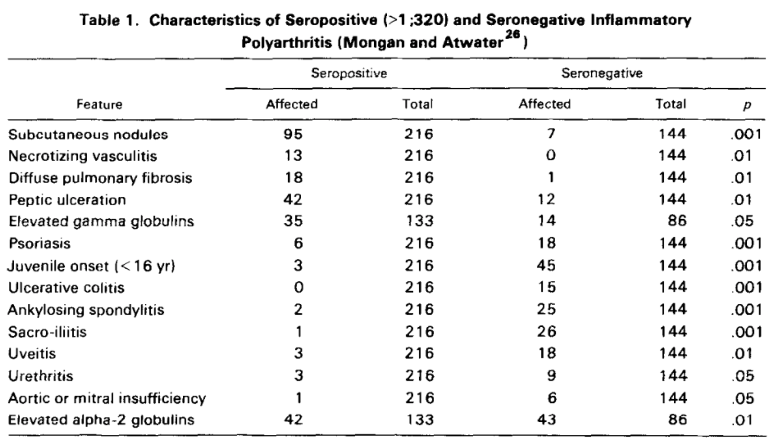
Comparison of Sero +ve and Sero –ve RA
Moll & Wright Semin Arthritis Rheum. 1973;3(1):55-78

Slide 7
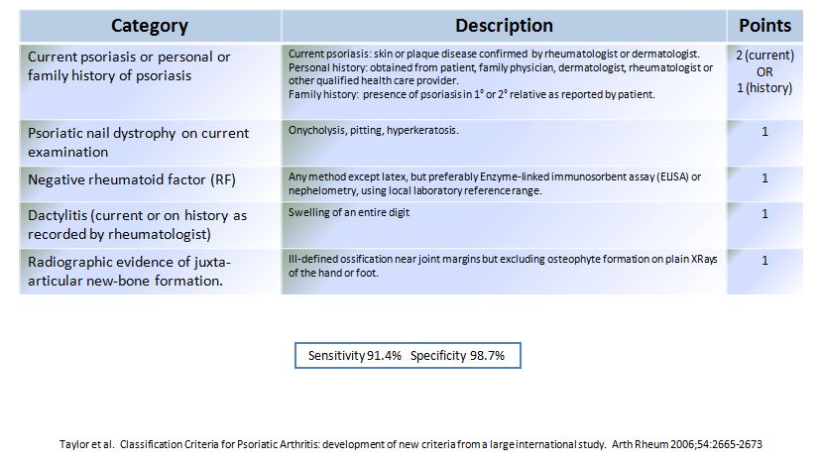
Diagnosis CASPAR Criteria

Slide 8
Part of Spondyloarthritis family
Ankylosing Spondylitis
Undifferentiated Spondyloarthritis
Eneteropathic
Spondyloarthritis
Juvenile Spondyloarthritis
Acute Anterior Uveitis
Psoriatic Arthritis
Reactive Arthritis

Slide 9
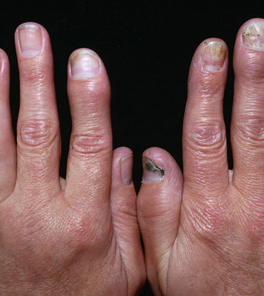
Epidimiology of PsA
10%¹⁻30%² of all patients with skin psoriasis
Joints can precede skin²
>50% polyarticular²
20-30% get erosive arthritis²
1-Gelfand et al. J Am Acad Derm 2005
2- Reich et al. Br J Dermatol 2009
3- Gladman et al. Ann Rheum Dis 2005
4- Sokoll et al. J Rheumatol 2001

Slide 10
Age of onset
Egeberg A et al. Ann Rheum Dis 2017

Slide 11
Gender distribution
Egeberg A et al. Ann Rheum Dis 2017
Notes:
Red Women, Green Men, Blue Overall

Slide 12
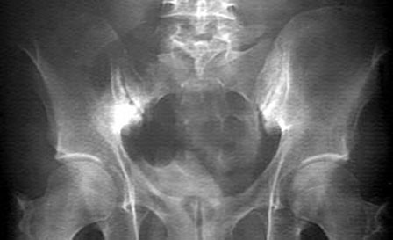
Axial Involvement
24% by X-ray criteria
27% if MRI included
More likely to get extra-articular features
Jadon et al. Ann Rheum Dis 2016
Van der Linden et al. Arthritis Rheum 1984
Peluso R et al., Clin Rheum 2015

Slide 13
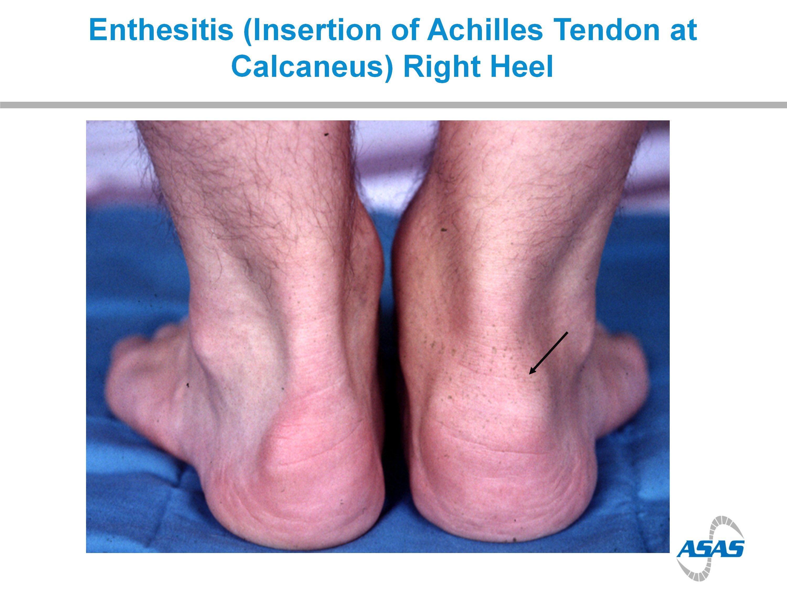
Nail involvement and enthesitis
Up to 80% of those with PsA (vs 40% in skin psoriasis)¹
35% of all PsA patients
1- Brazelli et al., Dermatol Venereol. 2012
2- Polachek et al., Arth Care & Res 2017

Slide 14
Scoring Enthesitis
Healy PJ et al., Ann Rheum Dis 2008

Slide 15
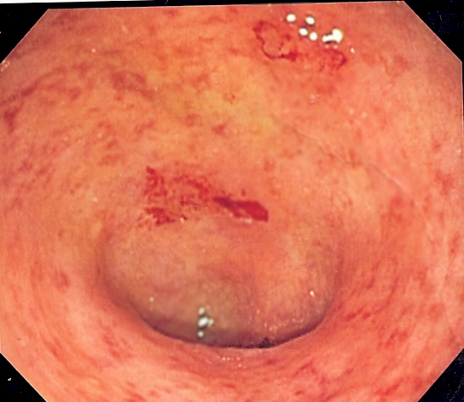
Extra-articular manifestations
IBD
Uveitis
8%
3%
Peluso R et al., Clin Rheum 2015

Slide 16
Higher co-morbidity in PsA compared to psoriasis without arthritis
Comorbidity | PsA | Psoriasis | P value | OR
Cardiovascular disease | 50 (8.2) | 15 (3.3) | 0.0016 | 2.59 (1.43–4.67)
Hypertension | 226 (37.1) | 88 (19.6) | < 0.0001 | 2.42 (1.82–3.22)
Hyperlipidemia | 126 (20.7) | 65 (14.5) | 0.0101 | 1.54 (1.11–2.14)
Type 2 diabetes mellitus | 73 (12.0) | 30 (6.7) | 0.0045 | 1.90 (1.22–2.96)
Obesity (BMI ≥30 kg/m2) | 183 (30.0) | 119 (26.5) | 0.0016 | 1.58 (1.19–2.09)
Respiratory disease | 68 (11.2) | 31 (6.9) | < 0.0001 | 1.69 (1.09–2.64)
Autoimmune disease | 55 (9.0) | 38 (8.5) | 0.7628 | 1.07 (0.69–1.65)
Liver disease | 17 (2.9) | 5 (1.2) | 0.0808 | 2.45 (0.90–6.69)
Depression/anxiety | 126 (20.7) | 41 (9.3) | < 0.0001 | 2.60 (1.78–3.78)
Cancer | 56 (9.2) | 20 (4.5) | 0.0039 | 2.17 (1.28–3.67)
Osteoporosis | 21 (3.5) | 13 (2.9) | 0.6773 | 1.61 (0.58–2.35)
Husted J A et al., Arth Care & Res 2011

Slide 17
Significant impact on quality of life
Unemployment rate 20-50%¹
Work Disability 16-39%¹
Quality of life impact similar to RA²
1- Tillett et al., Rheumatology 2012
2- Sokoll et al. J Rheumatol 2001

Slide 18
Talk Overview
Clinical picture & Diagnosis
Genetics
T cell biology & Pathogenesis
Treatment
Case studies

Slide 19
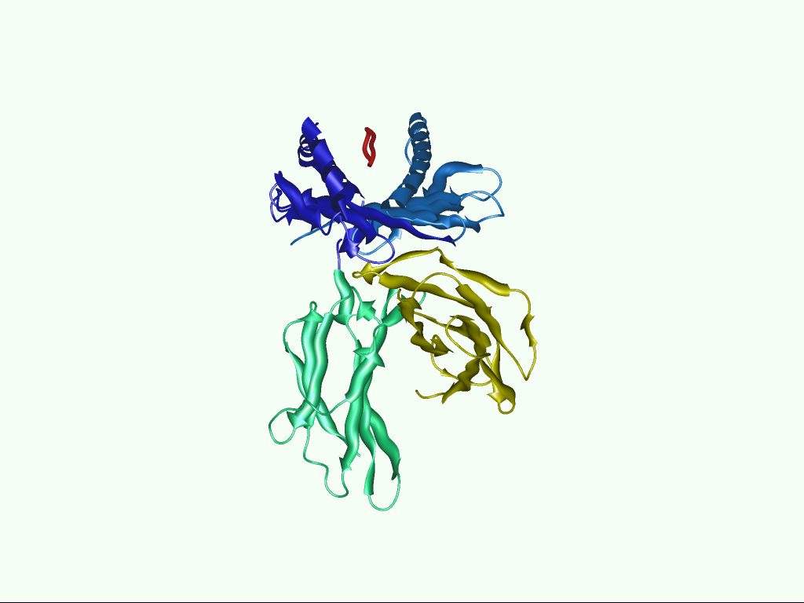
A role for HLA region
20% HLA-B27
WTCCC Nature Genetics 42, 2010
Bowness, Ann Rev Immunol 2015;33:29-48

Slide 20
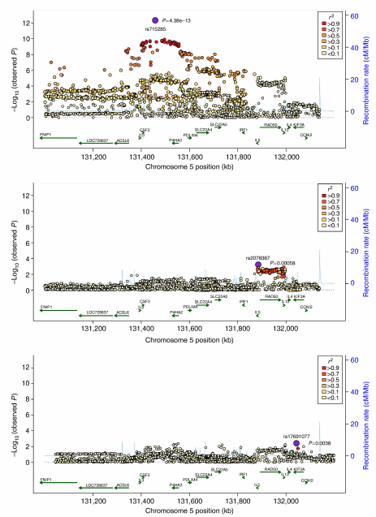
Genetics overlapping but also distinct from psoriasis
Bowes et al., Nature communications 2015

Slide 21
GWAS: Highlights T cell role
Stuart et al., AJHG 2015

Slide 22
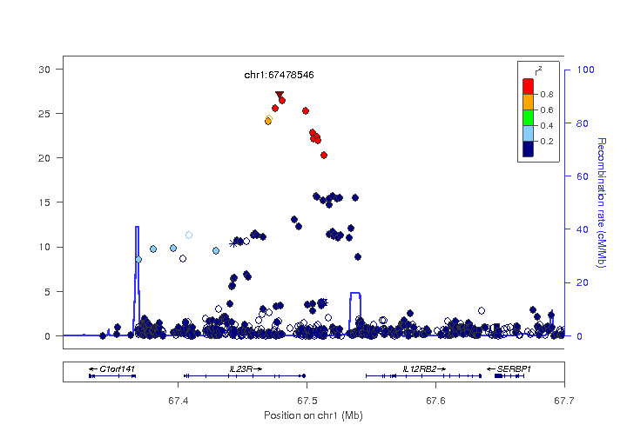
GWAS: IL-23R polymorphims
TASC Nature Genetics 2007;39:1329-1337
Notes:
Calin Criteria

Slide 23
Talk Overview
Clinical picture & Diagnosis
Genetics
T cell biology & Pathogenesis
Treatment
Case studies

Slide 24
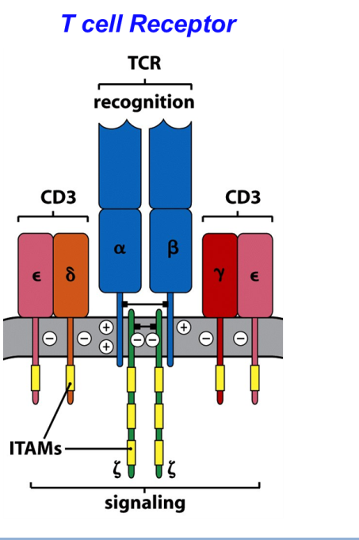
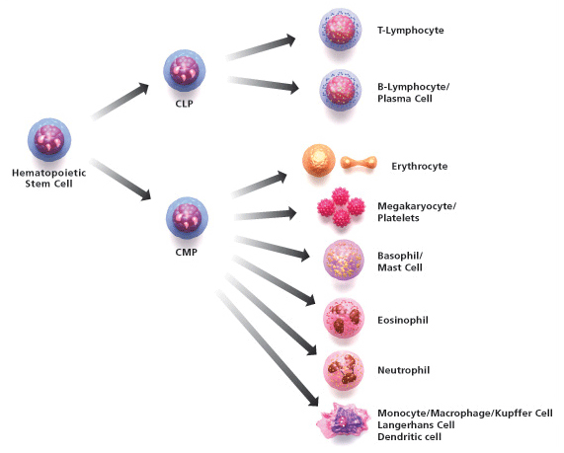
T cell Biology

Slide 25
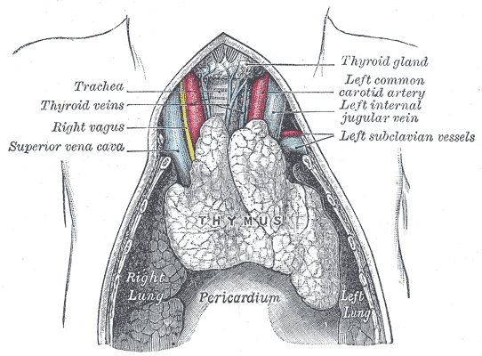
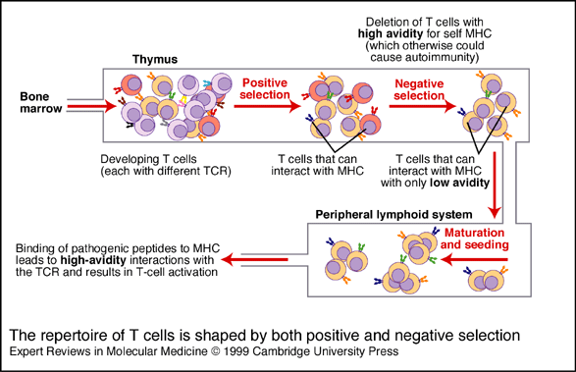
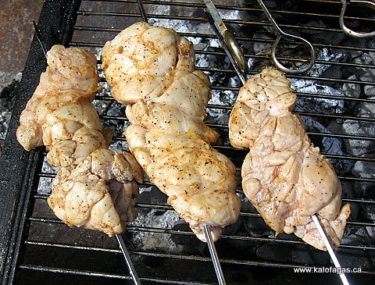
T cell maturation in the Thymus

Slide 26
T cells can only see antigen presented on MHC

Slide 27
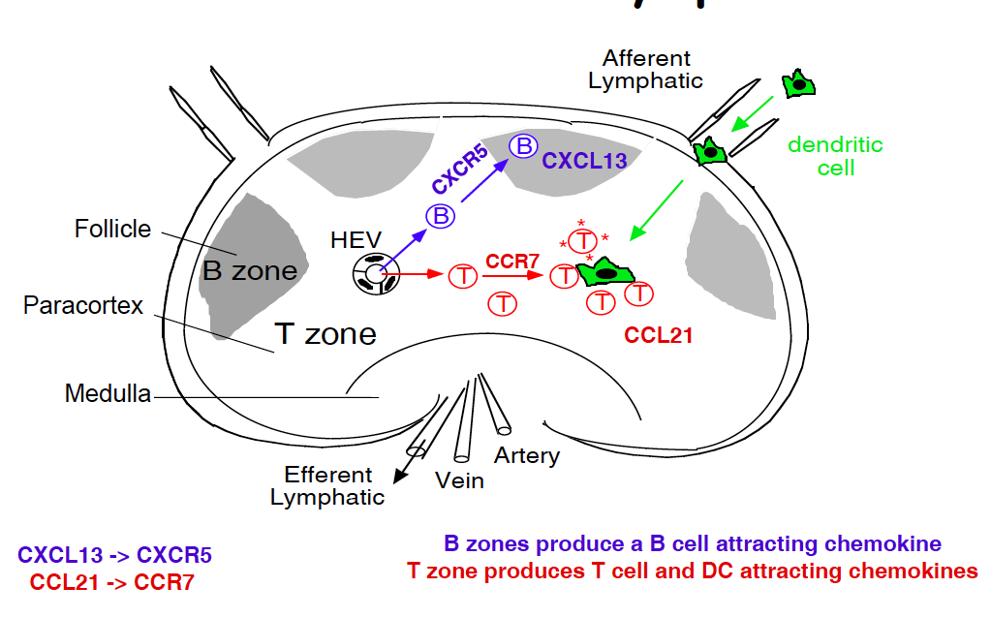
T cell activation happens at the lymph node

Slide 28
3 signals for T cell activation: Signal 1

Slide 29

3 signals for T cell activation: Signal 2
Lack of signal 2 = Anergy
Signal 2 expression only occurs in context of Danger
Gutcher et al., J Clin Invest. 2007
Matzinger Annu. Rev.lmmunol. 1994

Slide 30
Signal 2 controlled by CTLA-4
Vasaturo et al., Front .lmmunol. 2013

Slide 31
Signal 3 shaped the T helper response

Slide 32
Expanded Th17 cells in patients
Al-Mossawi et al. Nat Comms 2017

Slide 33
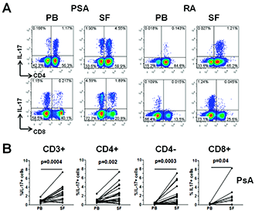
IL-17A from both CD4 and CD8 cells SpA joint
Menon et al, Arthritis & Rheumatism 2014

Slide 34
How does IL-17A contribute to inflammation?
Miossec et al. NEJM 2009

Slide 35
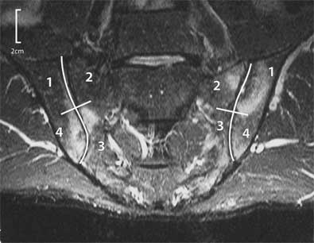
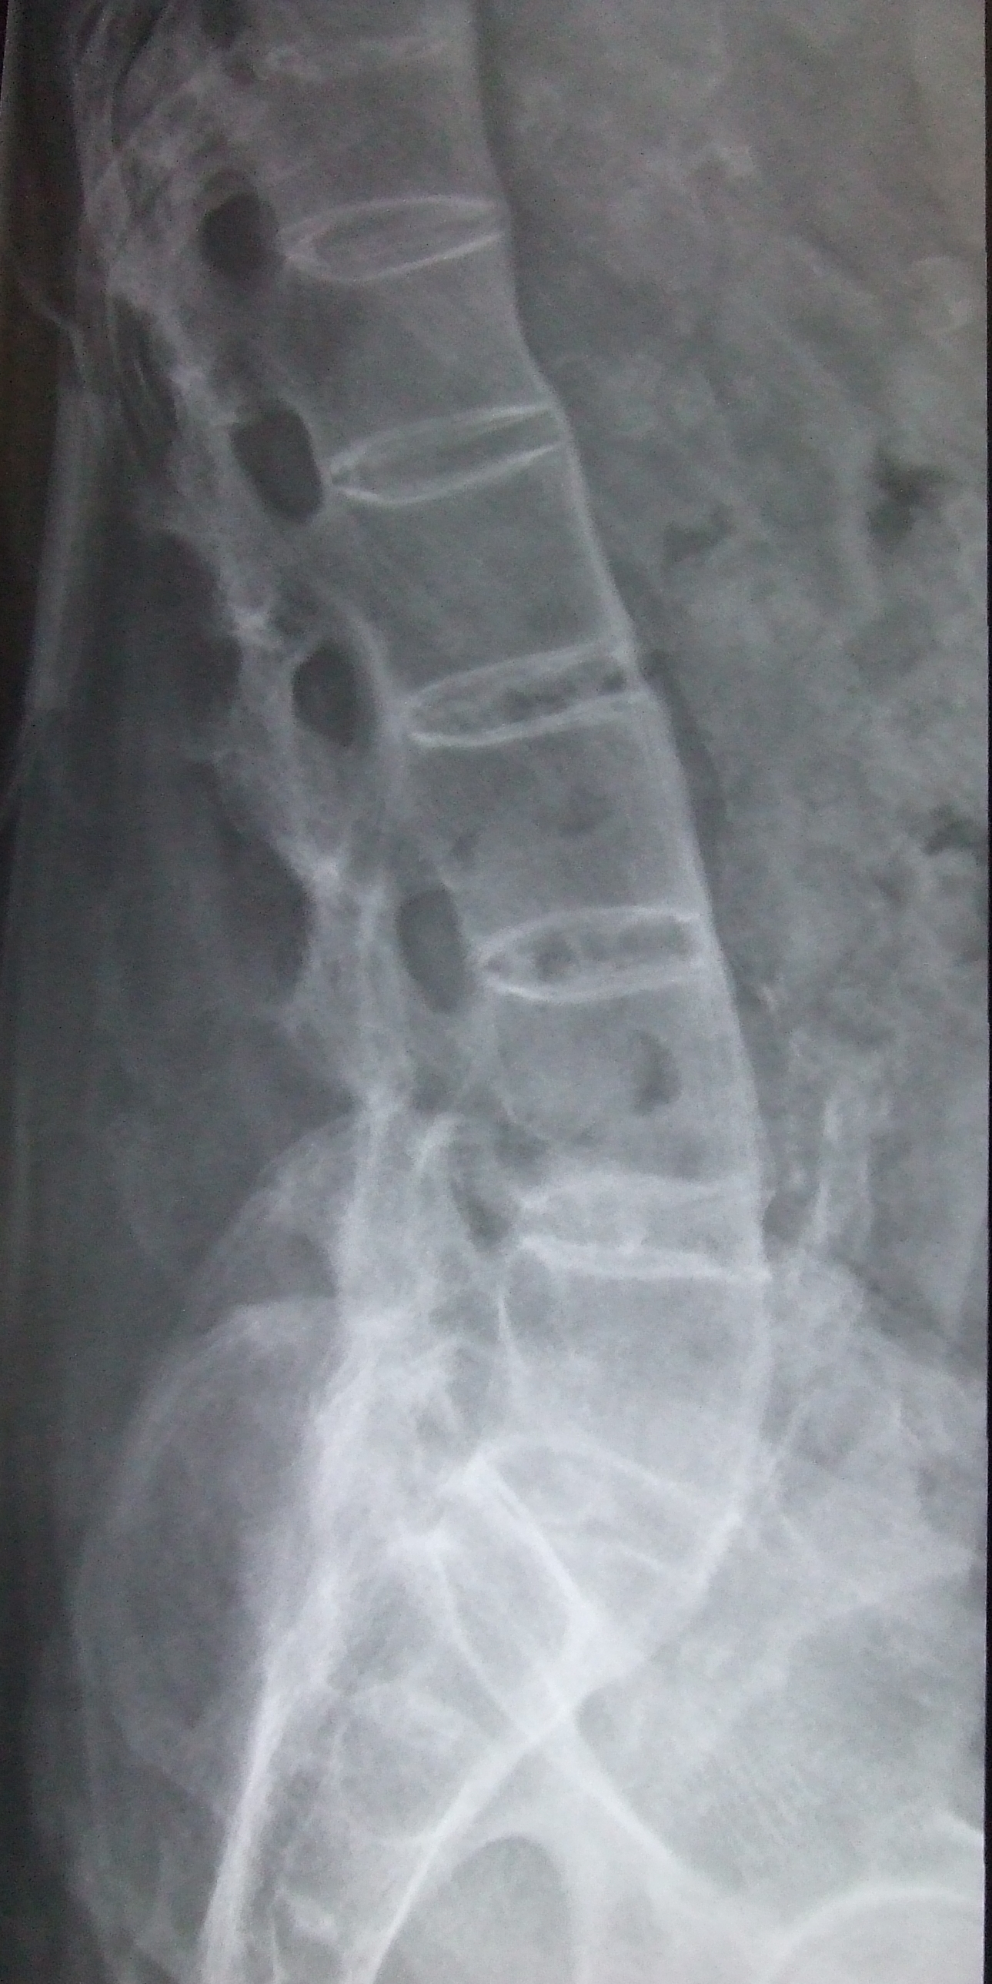
Concept of enthesis
McGonagle et al., Lancet 1998

Slide 36
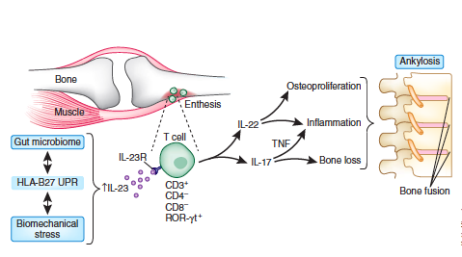
Resident cells at the enthesis
Sherlock et al., Nature Med 2012

Slide 37
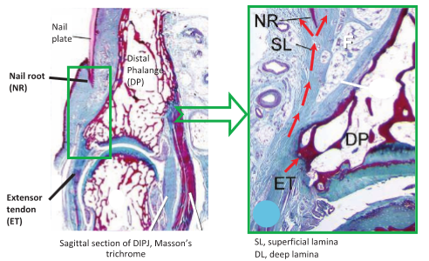
The nail as an enthesis
McGonagle D. J Eur Acad Dermatol Venereol 2009;

Slide 38
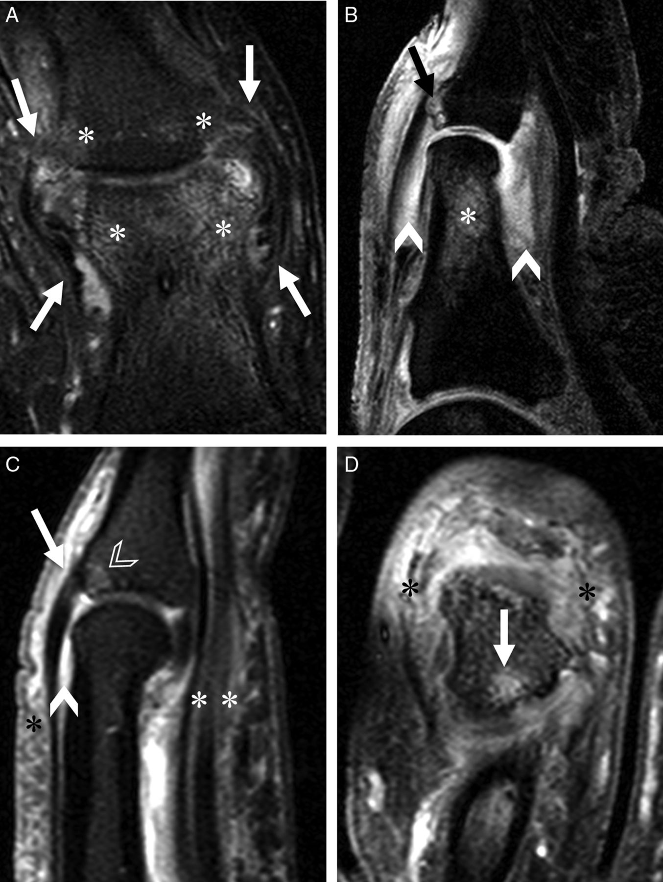
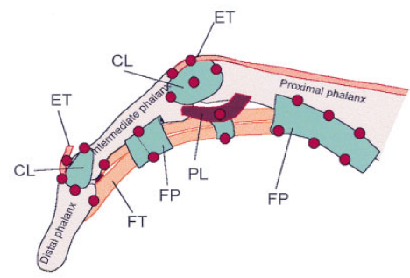
Dactylitis may be polyenthesitis
Tan AL, et al. Ann Rheum Dis 2015

Slide 39
Talk Overview
Clinical picture & Diagnosis
Genetics
T cell biology & Pathogenesis
Treatment
Case studies

Slide 40
Key Principle
Axial and Peripheral disease behave differently

Slide 41
Treatment of SpA Axial Disease
Specialist Physio
NSAIDs long term
1st line non-selective
2nd line COX2 eg Eterocoxib esp if GI side-effects
May reduce new bone formation
Biologics: Anti-TNF and now anti IL-17A
(Systemic DMARDs + Steroids don’t work)
Wanders A et al. Arthritis and Rheumatism 2005
Mease et al, NEJM 2015

Slide 42
Efficacy especially good in TNF naive
Sieper J, et al. Ann Rheum 2016

Slide 43
Treatment of PsA Peripheral Disease: 1st line
Intra-articular glucocorticoids
Systemic glucocorticoids
short term control of flares
May flare the skin
DMARDs
MTX commonly used as 1st line but no evidence of halting disease progression in RCTs. Does help skin
SSZ some evidence of efficacy but unclear if alters radiological progression
Often use MTX and SSZ in combination
Leflunomide, most evidence for efficacy but significant side effects
Ash et al, Ann Rheum Dis 2012

Slide 44
Treatment of PsA Peripheral Disease: NICE approved biologic therapies
Anti TNF allowed under the PsA technology appraisal TA199 (August 2010)
Peripheral arthritis with three or more swollen joints and
Failed trial of two synthetic DMARDs
Adequate response defined as improvement in 2/4 PsARC including TJC or SJC with no worsening in any parameter
Ustekinumab allowed since 2015 (Failed at 1st attempt 2014)
ACR20 response rate in TNF naïve: 42.4% (45mg), 49.5% (90mg), 22.8 (placebo)¹
ACR20 in TNF exposed: ~ 35% in all doses²
1- McInnes IB et al., Lancet 2013
2- Ritchlin C et al, Ann Rheum Dis 2012

Slide 45
Phosphodiesterase 4 inhibition (TA433)
Kavanaugh et al, Ann Rheum Dis 2014

Slide 46
Anti-IL-17A approved by NICE since May 2017 (TA445)
McInnes IB et al., Lancet 2015

Slide 47
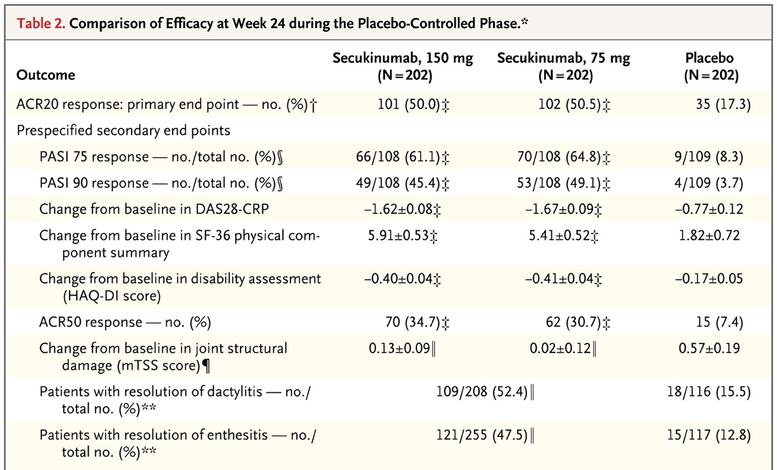
Enthesitis and dactylitis
Mease et al, NEJM 2015

Slide 48
Tight control is better
Coates et al, Lancet 2015

Slide 49
Talk Overview
Clinical picture & Diagnosis
Genetics
T cell biology & Pathogenesis
Treatment
Case studies

Slide 50
36 year old male
Axial and peripheral SpA
Stable on Anti-TNF (Humira) for 4 years
Developed neurological symptoms and MRI changes suggestive of demyelination
Switch to Secukinumab: Neurology resolved and maintained in remission
122 reported cases of CNS demyelination
36% full recovery after stopping
26% partial recovery
28% persistence
Kemanetzoglou, E., & Andreadou, E. Current Neurology and Neuroscience Reports 2017

Slide 51
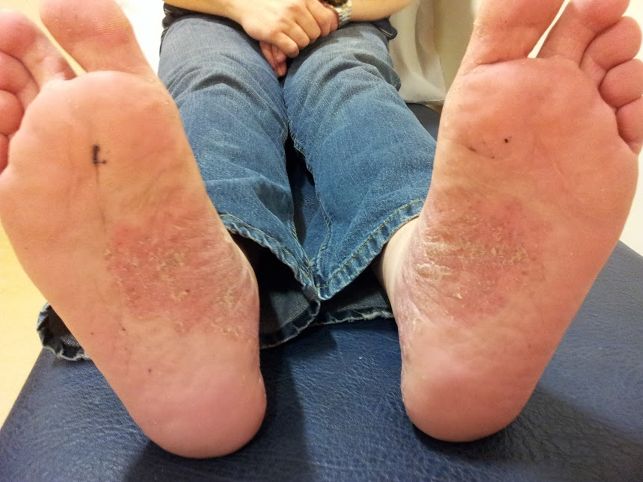
47 year old male
Presented with predominantly axial disease
Good response initially with anti-TNF
21/434 (4.8%) patients with IBD developed new psoriasis after TNF therapy over a 2 year period
52% palmo-pustular
Especially if smokers
Treated with anti-IL-17A, skin and axial disease responded
Tillack et al, Gut 2013

Slide 52
64 year old female
Predominantly peripheral spondyloarthritis and enthesitis
Well controlled on anti-TNF
Ductal carcinoma in-situ on breast screening
Switched to Ustekinumab early 2016: very severe flare of peripheral symptoms
Started anti-IL-17A in early 2017: very good response

Slide 53
Questions

